Slide 1
Testing Strategies for Sitecore

Slide 2
Introductions
Alistair Deneys
Solution Architect at Next Digital
Sitecore MVP
Creator of Revolver for Sitecore
Active Shared Source Contributor
EviBlog / WeBlog
http://adeneys.wordpress.com

Slide 3
What is Unit Testing
Unit testing is a development procedure where programmers create tests as they develop software. The tests are simple short tests that test functionality of a particular unit or module of their code, such as a class or function.
http://cplus.about.com/od/glossar1/g/unittesting.htm
In computer programming, unit testing is a method by which individual units of source code are tested to determine if they are fit for use. A unit is the smallest testable part of an application. In procedural programming a unit may be an individual function or procedure. In object-oriented programming a unit is usually a method.
http://en.wikipedia.org/wiki/Unit_testing

Slide 4
Unit Test Definition 2.0
A unit test is a fast, in-memory, consistent, automated and repeatable test of a functional unit-of-work in the system.
A unit of work is any functional scenario in the system that contains logic. it can be as short as a function, or it can span multiple classes and functions, and it provides internal or business value to the system under test.
Roy Osherove
http://osherove.com/blog/2009/9/28/unit-test-definition-20.html

Slide 5
Complexities of Unit Testing and Sitecore
Traditional App
Sitecore App
How do we isolate our code from Sitecore?

Slide 6
Overview of Testing Techniques
Testing Front End Code
Testing over HTTP
Web browser driver
Instantiate control in test
Testing Back End Code
With HttpContext (codeflood test runner)
Without HttpContext

Slide 7
Demos aplenty

Slide 8
Sacrifice to the Demo Gods

Slide 9
Testing Over HTTP
Basic Process
Request page using HttpRequest
Parse HTML as XML using HtmlAgilityPack
Use XPath to navigate and verify the output

Slide 10
Demo: Testing Over HTTP

Slide 11
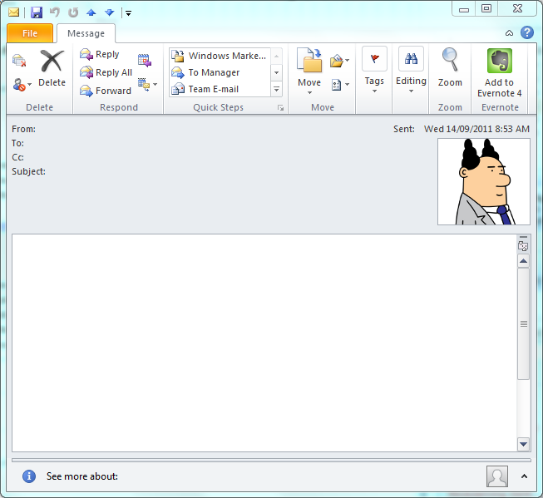
The Boss
The Dev
The Website’s not working
Hi Code Monkey,
The thumbnails aren’t showing up on the page.
Can you fix this ASAP?
Pointy Haired Pete

Slide 12
Testing Over HTTP
Drawbacks
Only tests the static structure
Javascript doesn’t run

Slide 13
Web Browser Driver
Basic Process
Use web browser driver to request page
Use web browser driver to interact with page
Use web browser driver to retrieve data from page
Common Web Browser Drivers
WatiN
Selenium

Slide 14
Demo: Web Browser Driver

Slide 15
The Boss
The Dev
The Website’s not working
Hi Code Monkey,
When I click on the filter button on the list page the list doesn’t get filtered
Can you fix this ASAP?
Pointy Haired Pete

Slide 16
Instantiate Control
Basic Process
Instantiate a Sitecore control in code
Parse output as XML (might need HtmlAgilityPack)
Use XPath to navigate and verify the output
Note
Test needs to run inside Sitecore application

Slide 17
Demo: Instantiate Control
Setup codeflood Test Runner

Slide 18
codeflood Test Runner
Custom Nunit test runner
Runs Nunit tests
Exists as ASPX so runs inside web application
Tests run in context of web application with HttpContext
http://www.codeflood.net/testrunner

Slide 19
Demo: Setup codeflood Test Runner

Slide 20
The Boss
The Dev
The Website’s not working
Hi Code Monkey,
Do you have a spare Nokia charger I can borrow?
Pointy Haired Pete

Slide 21
Demo: Instantiate Control

Slide 22
The Boss
The Dev
The Website’s not working
Hi Code Monkey,
When I check the field to exclude a page form the main menu it still gets included.
Can you fix this ASAP?
Pointy Haired Pete

Slide 23
Testing with HttpContext
Basic Process
Use codeflood test runner
Call Sitecore APIs
Verify code execusion

Slide 24
Demo: Testing with HttpContext

Slide 25
The Boss
The Dev
The Website’s not working
Hi Code Monkey,
That field auto-population thing we spoke about isn’t working.
Can you fix this ASAP?
Pointy Haired Pete

Slide 26
Testing without HttpContext
Basic Process
Copy Sitecore configuration
Call into Sitecore API
Keep in Mind
Page/Request lifecycle doesn’t run
No Sitecore Context

Slide 27
Demo: Testing without HttpContext

Slide 28
The Boss
The Dev
The Website’s not working
Hi Code Monkey,
Are you sure the category filtering stuff is working properly?
Can you fix this ASAP?
Pointy Haired Pete

Slide 29
Limitations of Techniques
HttpRequest
Test data setup more difficult (though not impossible)
Can’t test dynamic behaviours of page (Javascript, Ajax)
Web Browser Driver
Using PC whilst tests are running may be difficult
Requires proper threading model to run WatiN
Instantiate Control
Request lifecycle doesn’t run
Pipelines don’t run

Slide 30
Limitations of Techniques continued
With HttpContext
Tests may take longer to run
Without HttpContext
Setting up test environment is cumbersome

Slide 31
Test Data
Tests must run in a clean, environment with known inputs
Data required by tests must be created as commencement of test and destroyed at end of test
Create test data in TestSuiteSetup
Destroy data in TestSuiteTearDown
Doesn’t matter if data is created in web DB

Slide 32
Demo: Test Data

Slide 33
Larger Test Data
May be easier to create complex content structures using Sitecore tools, then recreate from XML
Tools to Export XML
Sitecore API
Sitecore Rocks
Revolver

Slide 34
Demo: Test Data from XML

Slide 35
Review
Testing Techniques
Through HTTP (HttpRequest and HtmlAgilityPack)
Web Browser Driver
Instantiate Controls
With HttpContext (codeflood test runner)
Without HttpContext
Test Data
Sitecore API
XML

Slide 36
What’s Next: Massif Massive

