Slide 1
Automated Testing with Sitecore V2

Slide 2
Introduction
Alistair Deneys
Developer on the CMS Team at Sitecore
Former MVP
Wrote the chapter on automated testing in the first official Sitecore book by John West
Creator of the Revolver module
http://adeneys.wordpress.com
adn@sitecore.net

Slide 3
Disclaimer
This is not the way Sitecore does testing
These are my views from my experiences
This presentation is about testing website implementations

Slide 4
What is unit testing?
Small automated tests to exercise a piece of code
Minimize (ideally to zero) any dependencies
Isolate the code under test
Repeatable
Reliable
Known input = expected output
INPUT
Code under test
INPUT
OUTPUT
INPUT

Slide 5
Why unit testing?
Easier to pin point the exact piece of code not working
Class
Class

Slide 6
This ain’t unit testing
Many of the following techniques are integration tests
The “units” of code are too large
Rely on too many dependencies
Cannot be run only in memory
Cannot be easily separated from Sitecore
…or can they
Man cannot live on unit tests alone
Professional projects require a good mix of both unit and integration tests

Slide 7
Definitions according to Roy
Unit Test Definition 2.0
A unit test is a fast, in-memory, consistent, automated and repeatable test of a functional unit-of-work in the system.
A unit of work is any functional scenario in the system that contains logic. it can be as short as a function, or it can span multiple classes and functions, and it provides internal or business value to the system under test.
Integration Test
An integration test usually is not in-memory: it may touch the disk file system, databases, registry or other shared resources. It may read or need a configuration file of the file system, wheas a unit test can be fully configured in-memory, for example.
An integration test will usually run much slower because it does not run in-memory.
An integration test can be less consistent – it may use threads or random number generators so that the result of the test is not always consistent.
Source: http://osherove.com/blog/2009/9/28/unit-test-definition-20.html

Slide 8
DEMO: A simple unit test

Slide 9
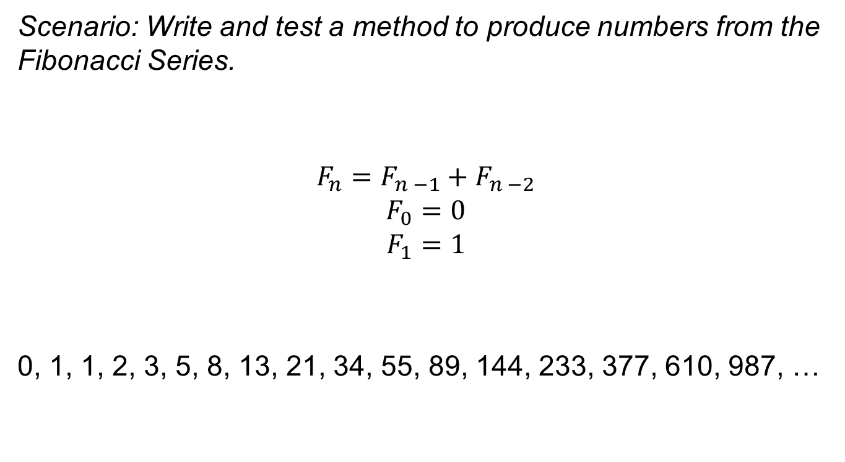
DEMO: A simple unit test
Scenario: Write and test a method to produce numbers from the Fibonacci Series.
$$F_{n}=F_{n −1}+F_{n −2}$$
$$F_{0}=0$$
$$F_{1}=1$$
0, 1, 1, 2, 3, 5, 8, 13, 21, 34, 55, 89, 144, 233, 377, 610, 987, …

Slide 10
DEMO: A simple unit test in Sitecore

Slide 11
DEMO: A simple unit test in Sitecore
Scenario: Test a functional component in Sitecore
Functional:
Accept inputs and return a result
Component does not acquire additional data
Component does not interact with globals

Slide 12
Why did it fail?
Lack of Sitecore configuration
Sitecore is not running
Our code is a small custom component, running in an existing application
My Application
Sitecore

Slide 13
DEMO: Embedded test runner

Slide 14
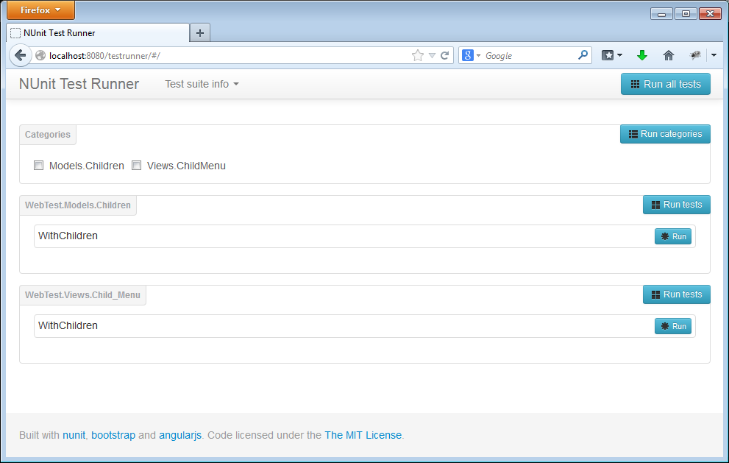
Embedded testing for MVC
NUnit Web Test Runner by Jorge Lusar http://marketplace.sitecore.net/en/Modules/NUnit_Web_Test_Runner.aspx

Slide 15
Managing test data
Tests against Sitecore components typically require test data
Don’t rely on the content tree not changing
Create the content you need for your test as part of your test
Destroy any content you create as part of your test at the end
Content
INPUT
Code under test
INPUT
OUTPUT
INPUT

Slide 16
Managing test data
Options:
Create content we require as part of test
API
XML
Use readonly content
Fixture Data Provider http://marketplace.sitecore.net/en/Modules/Sitecore_Fixture_DataProvider.aspx
Read content from serialized items
Read content from Sitecore packages

Slide 17
DEMO: Test content

Slide 18
Testing presentation components
How can we test presentation components?
[Deprecated] Testing over HTTP
Web Driver
Selenium
WatiN
Instantiate Components

Slide 19
DEMO: Testing presentation components

Slide 20
Views are for looking, not for testing
Testing the output can be brittle
Changes in the markup may break tests
Some components are very difficult to test
Sublayouts – May require events to be fired to render properly
Views should not contain logic
A module view may have small logic (display title, display image, etc)
Architecturally better to extract logic to functional components that are easier to test
At the very least, structure components to allow for testing

Slide 21
DEMO: Refactor for testing

Slide 22
It’s working, but we can do it better
Using an embedded test runner is heavier than it needs to be
Sitecore is running
Need HttpContext
Databases are accessed
Much configuration needed
Note: At least everything works the way it should

Slide 23
Let’s do without
HttpContext
Database
Already done: Fixture
Mock the content tree
Phantom http://marketplace.sitecore.net/en/Modules/Phantom_-_tesk_kit_fo_Sitecore.aspx
Create in memory test content
Sitecore / Config (running anyway)

Slide 24
DEMO: Testing without

Slide 25
Some general tips
Don’t forget good dev practices, even for tests. Make use of methods.
Make sure you have enough tests

Slide 26
Conclusion
How to test against the Sitecore API
Embedded Test Runner
Without HttpContext
Managing test data
Create using API
Create from XML
Fixture
Testing presentational components
XSLT
Refactoring for testing
Mocking and Isolation
Phantom
Moq
TypeMock

Slide 27
References
NUnit testing framework http://www.nunit.org/
codeflood test runner http://www.codeflood.net/testrunner/
Fixture data provider http://marketplace.sitecore.net/en/Modules/Sitecore_Fixture_DataProvider.aspx
Phantom content mocking http://marketplace.sitecore.net/en/Modules/Phantom_-_tesk_kit_fo_Sitecore.aspx
NUnit Web Test Runner http://marketplace.sitecore.net/en/Modules/NUnit_Web_Test_Runner.aspx
Moq https://github.com/Moq/moq4
TypeMock Isolator http://www.typemock.com/

Slide 28
Presentation materials
PowerPoint Deck http://www.codeflood.net/files/automated-testing-sitecore-v2.pptx
Complete code http://www.codeflood.net/files/automated-testing-sitecore-v2-code.zip

Slide 29
Thank You

